Slide 1
Implementing CCBHC Implementation guidance for Certified Community Behavioral Health Clinics (CCBHC)
Wednesday, June 7, 2017

Slide 2
DHS Team
Jennifer Blanchard, Community and Care Integration Director
Amanda Calmbacher, TCM policy
Gary Cox, Medicaid Supervisor
Dwight Heil, Children's Mental Health
Jane King, Certification Specialist
Michelle Maruska, ADAD Project Manager
Leah Montgomery, Community and Care Integration Policy
Julie Pearson, CCBHC Project Manager
Lucas Peterson, MCO Liaison
Ma Xiong, Quality of Care Analyst
John Zakelj, Payment Specialist

Slide 3
Background
Julie Pearson – CCBHC Project Manager
Notes:
Direction for Participants to reflect on accomplishments and future opportunities – write down on cards provided on tables

Slide 4
CCBHC Demonstration Timeline
In 2014, the U.S. Congress enacted the Excellence in Mental Health Act, which established an eight-state demonstration project to test CCBHCs (PAMA, Section 223).
The 2015 Minnesota legislature provided funding to support planning and Minnesota received a SAMHSA planning grant.
The 2016 Minnesota legislature appropriated state Medicaid match.
In December 2016, Minnesota was chosen to be one of eight states to pilot CCBHC.
Clinics will begin providing services under the CCBHC model by July 1, 2017. During the demonstration period, states will receive an enhanced federal match on Medicaid for the services provided by CCBHCs. The pilot is scheduled to run until June 30, 2019.

Slide 5
CCBHC Demonstration Opportunities
CCBHC service delivery model
Comprehensive, trauma-informed, evidence based, person- and family-centered services including care coordination
Serve all ages
Provide outreach and increase access to underserved populations
Serve as a “one-stop-shop”
Free choice of providers
Notes:
Service Model: The demo gives the states an opportunity to pilot a set of new federal standards for comprehensive, coordinated services within one organizational structure “one stop shop”. The emphasis is on delivering high quality, evidence best practices, providing outreach/engagement to underserved population, providing services outside the four walls in setting like jails, in-home, schools and the community.
CCBHCs will serve all ages and focus on underserved populations – veterans, people of color, people for whom English is not their primary language, people who are homeless…
Care Coordination is the linchpin of the model – responsible for overall care coordination for behavioral health, primary care and social services – individuals will continue to have free choice of provider.
This new service delivery model aims to coordinate care across settings and providers to ensure seamless transitions for individuals across the full spectrum of health and social services, increase consistent use of evidence-based practices, and improve access to high-quality care. As part of the state’s participation in the demonstration program, CCBHCs will provide an array of required services, including crisis, outpatient mental health and substance use disorder services, targeted case management, rehabilitative services, care coordination

Slide 6
CCBHC Demonstration Opportunities
CCBHC payment model (Prospective Payment Rate – PPS)
PPS rate is unique to each CCBHC
Rate based on allowable costs of furnishing all CCBHC services
Same rate is paid for each qualifying day of service (“visit”), regardless of the intensity of services provided
Opportunity to receive bonus payments for meeting quality measure targets
Notes:
Payment Model: opportunity to pay differently

Slide 7
Need for Continued County Coordination
Changes to county authorization and payment for TCM and Chemical Dependency Services
Coordination and support in accessing county services remains critical for individuals receiving CCBHC services
County maintains their role/responsibility to individuals who are not on Medical Assistance
Counties maintain their legal responsibility and authority under the Commitment Act
Notes:
a county will not be responsible for the typical county share when Medical Assistance pays for a CCBHC to perform outpatient Substance Use Disorder (SUD) services or Rule 79 Mental Health Targeted Case Management.
Clients will also have direct access to these services, without county approval or authorization.
CCBHC and the county/counties will maintain an ongoing relationships to facilitate access and continuity of care, especially for individuals who are uninsured or who may go on and off medical assistance. This is similar to the letters provided by a county in response to a Rule 31 application.

Slide 8
CCBHC States
Minnesota
Missouri
New York
New Jersey
Nevada
Oklahoma
Oregon
Pennsylvania

Slide 9
Selection Process
Organizational Readiness Assessment
Geographical Needs Assessment
Certification Process
organizational policy and work plan development
staff training, recruitment and hiring
Notes:
ACCOMPLISHMENT: Highlight all the work of the Clinics to prepare for certification as an Accomplishment!

Slide 10
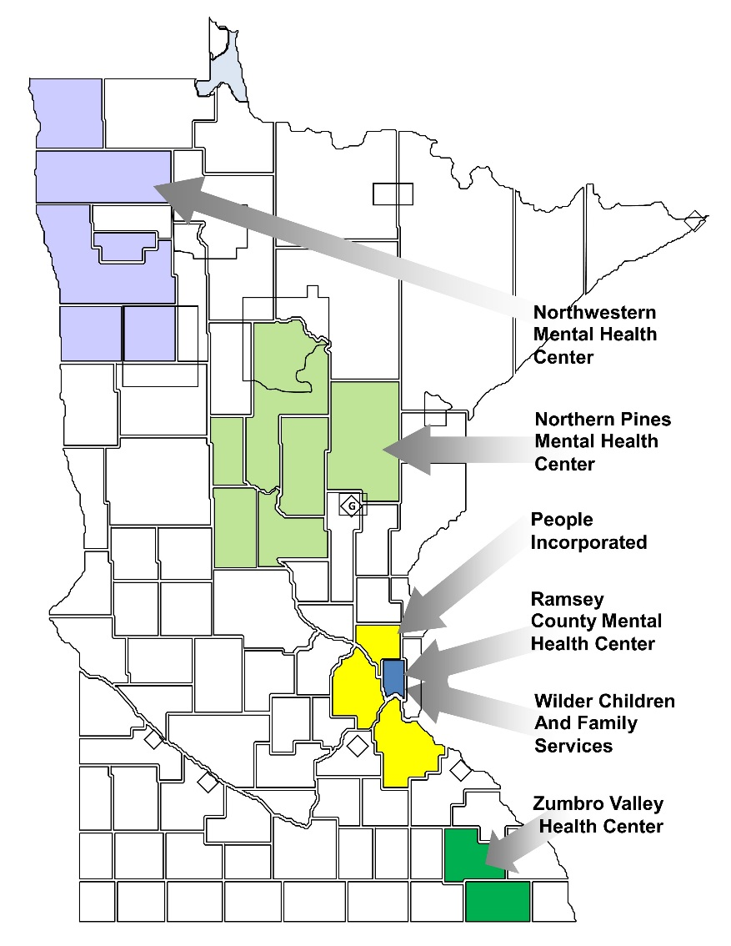
CCBHC Clinics
Northern Pines Mental Health Center
Northwestern Mental Health Center
People Incorporated
Ramsey County Mental Health Center
Wilder Children and Family Services
Zumbro Valley Health Center

Slide 11
Federal Criteria for Services
Program Requirements
Staffing
Availability and Accessibility of Services
Care Coordination
Scope of Services
Quality and other Reporting
Organizational Authority, Governance and Accreditation
Section 223 Program Requirements - full criteria

Slide 12
State Specific Standards
Rule 31 Chemical Dependency License
Rule 29 Mental Health Center/Clinic Certification
ARMHS Certification
CTSS Certification
TCM Services (adults and kids)
Crisis Response Services (adults and kids)
Rule 47 – Medicaid standards for outpatient mental health services
Notes:
Minnesota’s CCBHC must meet not only the federal standards, but Minnesota-specific standards. The 6 pilot sites had these services in place initially or worked during the planning phase to bring up these services.
Opportunity: The demonstration is an opportunity to identify overlapping and duplicative program standards to create variances in existing standards during the demonstration period.
Opportunity: Potential to influence longer term reform to a single set of licensure/certification standards.
Opportunity: to provide Integrated Treatment for COD through an additional certification to existing Rule 31/29.

Slide 13
State-Specific Standards
Evidence Based Practices:
Motivational Interviewing
CBT
Stages of Change
Trauma Treatment
TF-CBT (Children)
EMDR (Adults)
Seeking Safety (Adults)
Peer Recovery Services:
Certified Peer Specialist
Family Peer Specialist
Recovery Support Specialist
Notes:
As a condition of the demonstration states selected required EBPs. Minnesota chose MI, CBT, Stages of Change and a trauma treatment for adults and kids. Minnesota’s standards require the inclusion of peer services; CPS for adults, Family Peers for families, and Recovery Support Specialists trained in providing peer supports to persons in recovery from a SUD.
OPPORTUNITY: increase access to high quality, evidenced based care

Slide 14
CCBHC Services
Jane King – CCBHC Certification Specialist

Slide 15
Who is considered a CCBHC recipient?
An individual who is currently receiving services from one of the six identified CCBHCs.
Must receive one or more of the nine CCBHC services from the CCBHC to be considered a recipient.
An individual who is new to receiving services from one of the six identified CCBHCs.
Must have a completed a preliminary screening and risk assessment and receive one or more of the nine CCBHC services from the CCBHC to be considered a recipient.
No enrollment process.
Notes:
On 7.1.17 a member who is currently being served by a CCBHC and receives any CCBHC service is considered a CCBHC recipient. Or a member who receives a preliminary Risk Assessment and one CCBHC service is considered a CCBHC recipient. There is no enrollment process.
A “new” client is defined as someone who has not received a service from the CCBHC in the last 6 months.

Slide 16
CCBHC Services
Outpatient mental health and substance use services
Primary care screening and monitoring
Screening, assessment and diagnosis, including risk management
Crisis mental health services, including 24-mobile crisis teams, emergency crisis Intervention services and crisis stabilization
Person-centered treatment planning
Targeted case management
Peer and family support
Services for members of the armed forces and veterans
Connections with other providers and systems
Psychiatric rehabilitation services

Slide 17
Scope of Services
Aligns coverage policy w/ demonstration objectives
Policy change examples:
Expand coverage across the age span
Allow for a more person-centered assessment
Expedites access into services
Increases access to Certified Peer Specialist and Peer Recovery Supports
Opportunity – to align future coverage policy statewide

Slide 18
Scope of Services Table
DHS has issued a Scope of Services table which translates the federally required and optional CCBHC services into specific procedure codes for Minnesota
The table includes 47 existing procedure codes and one new procedure code
The new procedure code is H0014 Withdrawal Management Level 2
Seven existing procedure codes involve changes and expansions in coverage to comply with CCBHC criteria
The Q2 modifier designates coverage changes which apply only to the CCBHC demo; Q2 facilitates bypass of current claims processing edits.
Notes:
ACCOMPLISHMENT/FUTURE OPPORTUNITY- created an Integrated MH-SUD Category of Service within MMIS System

Slide 19
Coding and Service Changes with Q2 Modifier
90899-Q2- Clinical Care Consultation for adults 21+
H2027-Q2- Family Psychoeducation for adults 21+
H0032- Q2-UD - Treatment Plan Development: bypass current authorization thresholds and expand beyond ARMHS and CTSS
H0038-Q2 - Peer Support for people in recovery from chemical dependency
90791/90792-Q2-52 – Brief DA is redefined to be consistent with CCBHC criteria for the Initial Evaluation; and to allow additional sessions
90791/90792-Q2 – Diagnostic Assessments: bypass current authorization thresholds

Slide 20
Coding and Service Changes without Q2 Modifier
H0031- UD - Functional Assessment expanded beyond ARMHS and CTSS
H0038- MH Peer Specialist services expanded beyond ARMHS and CTSS
MMIS is being reprogrammed to allow CCBHCs to bypass current edits which restrict these codes to service locations that have a CTSS or ARMHS package of service; as far as we know, this will not be an issue for MCOs

Slide 21
Prospective Payment System (PPS)
John Zakelj – Mental Health Division

Slide 22
Current MA payment model
Fixed rates per unit of service
Rates are inadequate to support quality services
Incentive is for quantity over quality
Limited flexibility to tailor services to individual needs
Separate payment structures for mental health and substance abuse disorder services

Slide 23
CCBHC payment model (Prospective Payment Rate – PPS)
Reimbursement based on actual and projected costs of serving CCBHC consumers, not on fee schedule
PPS rate is unique to each CCBHC
Rate based on allowable costs of furnishing all CCBHC services
Same rate is paid for each qualifying day of service (“visit”), regardless of the intensity of services provided
Integrated payment for mental health and substance abuse disorder services
DHS has worked collaboratively with our CCBHCs, MCOs and state MMIS to implement this model in Minnesota. See following slides.
Notes:
ACCOMPLISHMENT – A step towards unified payment for mental health and SUD services

Slide 24
CCBHC payment model (Prospective Payment Rate – PPS)
Will provide about $30 million per year in new state and federal funding
Most of the new funding will come in supplemental wrap payments
Wrap payments will support integrated, coordinated, quality services
We preferred a full, upfront PPS payment, but the wrap payment was a compromise for the demo, due to a number of factors
Notes:
ACCOMPLISHMENT – A step towards unified payment for mental health and SUD services

Slide 25
PPS Payment: Demo vs Post-Demo
In order to meet the CCBHC timelines Minnesota is working with a contractor to develop a payment infrastructure process specific to this project. See wraparound payment methodology slide
Upon permanent enactment of CCBHC in Minnesota, PPS methodology will be fully implemented in the State payment system.
This time-limited payment process mitigates the re-programming burden on the State’s legacy MMIS and MCO claims-payment systems and reconciles traditional payments with PPS rates.
Continuation of billing by procedure code during the demo captures data required for the national CCBHC evaluation
Notes:
OPPORTUNITY - permanent implementation into the state’s payment system.

Slide 26
PPS Rates: First Year vs Second Year
PPS Rates for Year 1 (July 1, 2017 to June 30, 2018) will be communicated to CCBHCs mid-June 2017
Rates will be based on actual costs from a recent fiscal year, plus approved anticipated costs for Year 1, plus an inflation factor.
Early in 2018, DHS will, in consultation with the CCBHCs, determine whether to rebase rates for Year 2.
If rates are not rebased, rates for Year 2 will be the same as Year 1 plus an inflation factor

Slide 27
Wraparound Payment Methodology
For this two-year demo, Minnesota will use a uniform wraparound payment methodology for all qualified Medicaid recipients, including fee-for-service (FFS) and managed care.
MCOs and the state’s FFS system will pay a rate to the CCBHCs that other providers would receive for similar services.
The State will make a supplemental payment (wraparound) to ensure payment to CCBHCs is equal to the PPS to ensure that all CCBHCs receive the full PPS rate plus appropriate Quality Bonus Payments for all qualified recipients.
If the minimum payment was not achieved, the state (not the MCO) will make supplemental payments to the CCBHCs to make up the shortfall.
This methodology includes ongoing oversight of all managed care payments to CCBHCs and a monthly reconciliation process between the state and the CCBHCs.

Slide 28
CCBHC Payment Timeline
Payment for currently covered services will continue as is
For services that are expanded (see earlier slide), CCBHCs will receive payment retroactive to dates of service after July 1, 2017
Wrap payments will be made on the following schedule:
For fee-for-service claims, about a month after the claim is processed
For managed care claims, about 2 months after the claim is processed

Slide 29
Quality Bonus Payments
CCBHCs will be eligible for Quality Bonus Payments based on their performance on quality measures described in a later slide
The first bonus payments will be made after data is complete regarding performance during Year 1
The second bonus payments will be made after data is complete regarding performance during Year 2
These bonus payments will be in addition to all other payments and can average up to a 5% add-on to the other payments

Slide 30
Ideas for group discussion of payment issues
How will your clinic use this new payment system as an opportunity to improve services?
What are your main concerns regarding payment plans?
Idea for addressing your concerns

Slide 31
Evaluation

Slide 32
CCBHC State Lead Measures
Lori Allerson – Health Research and Quality

Slide 33
State Lead CCBHC Demonstration Measures
13 CCBHC demonstration measures required by SAMHSA
Housing status – client living situation by each clinic
Patient Experience of Care Survey – SAMHSA Mental Health Statistics Improvement Program (MHSIP) Adult Consumer Experience of Care Survey by clinic
Youth/Family Experience of Care Survey – SAMHSA survey reported by clinic
10 NCQA HEDIS measures

Slide 34
State Lead HEDIS Measures
Acronym | Measure | Quality Bonus Measure
ADD | Follow-up care for children prescribed ADHD medication | N
AMM | Antidepressant Medication Management | N
FUA | Follow-up after ED Visit for Alcohol and Other Drug | N
FUH – C | Follow-up after Hospitalization for Mental Illness (child/adolescent) | Y
FUH – A | Follow-up after Hospitalization for Mental Illness (adult) | Y

Slide 35
State Lead HEDIS Measures (cont’d)
Acronym | Measure | Quality Bonus Measure
FUM | Follow-up after ED Visit for Mental Illness | N
IET | Initiation and Engagement of Alcohol and Other Drug Treatment | Y
PCR | Plan All-Cause Readmission Rate | Y
SAA | Adherence to Antipsychotics for Individuals with Schizophrenia | Y
SSD | Diabetes Screening for Individuals with Schizophrenia using Antipsychotics | N

Slide 36
Demonstration Quality Bonus Measures
Acronym | Measure | Lead of Measure
FUH - C | Follow-up after Hospitalization for Mental Illness (child) | State
FUH - A | Follow-up after Hospitalization for Mental Illness (adult) | State
IET | Initiation and Engagement of Alcohol and Other Drug Treatment | State
SAA | Adherence to Antipsychotics for Individuals with Schizophrenia | State
SRA - C | Major Depressive Disorder: Suicide Risk Assessment (child) | Clinic
SRA - A | Major Depressive Disorder: Suicide Risk Assessment (adult) | Clinic
CDF | Screening for Clinical Depression and Follow-up Plan | Clinic
PCR | Plan All-Cause Readmission Rate | State
DY1 bonus
DY1 bonus
after 6 mo.
Include in
DY2 bonus

Slide 37
RDA and HEDIS validation audit
Research and Data Analysis
Provide high-quality data analysis and research analysis to inform administrators, policy makers, public about Minnesota Health Care Programs
HEDIS measures
Annually review, modify, or add HEDIS measures based on priorities at DHS
Run year 2017 – 36 HEDIS measures
Vendor reviews capabilities of DHS’ ability to produce HEDIS reports
Report results by MHCP and MCO
NEW for Run year 2017 – report results by MHCP

Slide 38
CCBHC HEDIS measures
SAMHSA HEDIS specification generally the same except…
Stratify by Medicaid, Medicare and Medicaid dual eligibles, or other
Report by provider entity (BH clinic)
Demonstration year time period
DY1: July 1, 2017 – June 30, 2018
DY2: July 1, 2018 – June 30, 2019
Some measures specify appropriate practitioners
Practitioner with prescribing authority, mental health practitioner, any practitioner

Slide 39
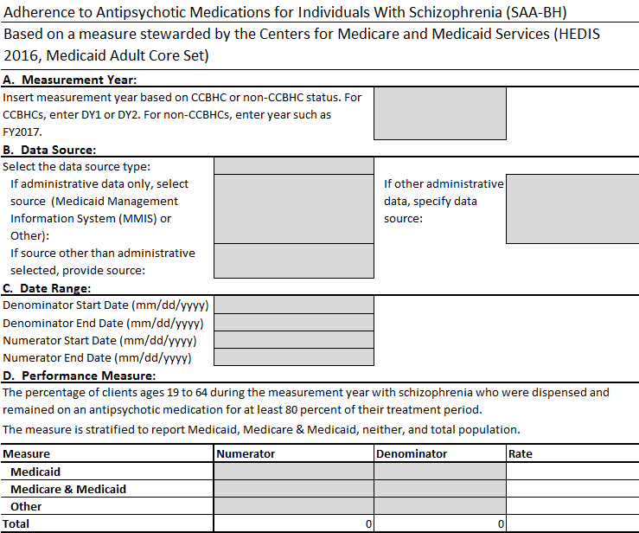
Example SAMHSA reporting template (SAA)

Slide 40
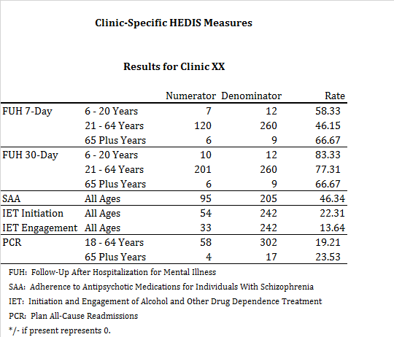
Quarterly reporting to BH clinics

Slide 41
CCBHC Clinic Lead Measures
Ma Xiong, Quality of Care Analyst – Mental Health Division

Slide 42
CCBHC Clinic Lead Measures
CCBHCs will report data for 9 measures required by SAMHSA (known as Clinic lead or BHC-lead measures)
The Measurement Years are:
DY1: July 1, 2017 – June 30, 2018
DY2: July 1, 2018 – June 30, 2019
Measurement periods may differ according to measure
Stratify by Medicaid, Medicare and Medicaid dual eligibles, or other
Stratify by age groups if applicable
Report by provider entity (CCBHC)
DHS submits data received from each CCBHC to SAMHSA
Notes:
Example: Time to Initial Evaluation Measure
Measurement Period
Denominator: Measurement year excluding last 30 days and including the 6 months preceding the measurement year.
Numerator: Measurement year.

Slide 43
Clinic Lead Measures
Measure Name | Measure Steward | NQF # | CCBHC Quality Bonus Measure
Time to Initial Evaluation (I-EVAL) | SAMHSA | NA
Preventive Care and Screening: Adult Body Mass Index (BMI) Screening and Follow-Up (BMI-SF) | CMS | 421
Weight Assessment and Counseling for Nutrition and Physical Activity for Children/Adolescents (WCC-BH) | NCQA | 24
Preventive Care & Screening: Tobacco Use: Screening & Cessation Intervention (TSC) | AMA-PCPI | 28
Preventive Care and Screening: Unhealthy Alcohol Use: Screening and Brief Counseling (ASC) | AMA-PCPI | 2152
Child and Adolescent Major Depressive Disorder (MDD): Suicide Risk Assessment (SRA-BH-C) | AMA-PCPI | 1365 | Federal Required
Major Depressive Disorder: Suicide Risk Assessment (SRA-A) | AMA-PCPI | 104 | Federal Required
Screening for Clinical Depression and Follow-Up Plan (CDF-BH) | CMS | 418 | MN Required
Depression Remission at Twelve Months (DEP-REM-12) | Minnesota Community Measurement | 710
Notes:
9 federally required clinic lead measures

Slide 44
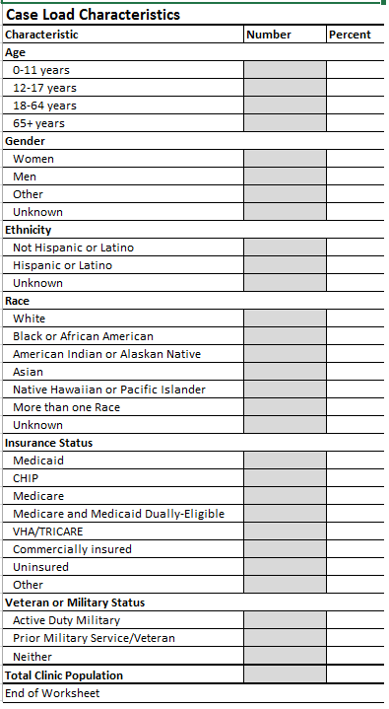
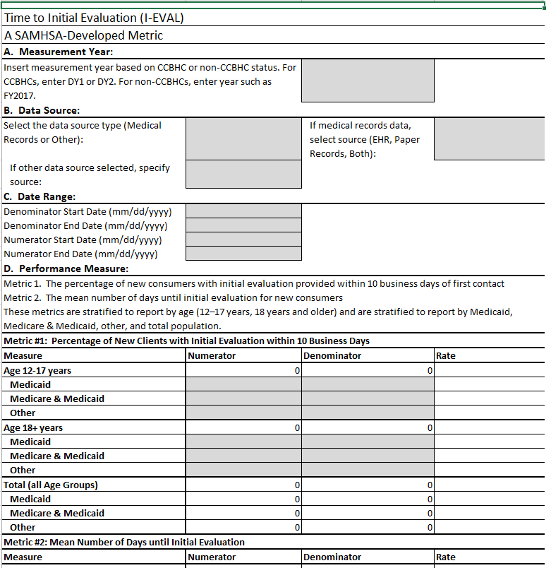
SAMHSA Reporting Templates for Clinic-Lead Measures
Notes:
SAMHSA reporting template:
https://www.samhsa.gov/sites/default/files/demonstration-223-templates-omb.xlsx

Slide 45
Impact Measures
Evaluate impact of Minnesota’s participation in CCBHC service delivery model
8 Minnesota impact measures
Clinics will submit consumer level data that will be used to calculate the measures
Notes:
Eight measures were selected to show the impact on the target populations served by CCBHCs over the two-year demonstration period.
The measures were defined with the assistance of an external consultant who facilitated several meetings with the six CCBHC and DHS staff using Results-Based Accountability® (RBA) practices.
The measures were grouped into two broad categories: Population Accountability and Program Performance Accountability.

Slide 46
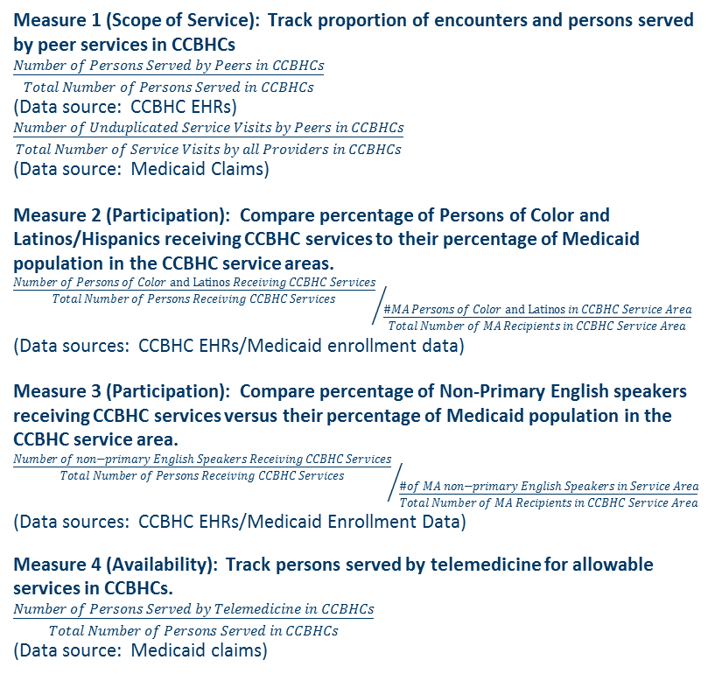
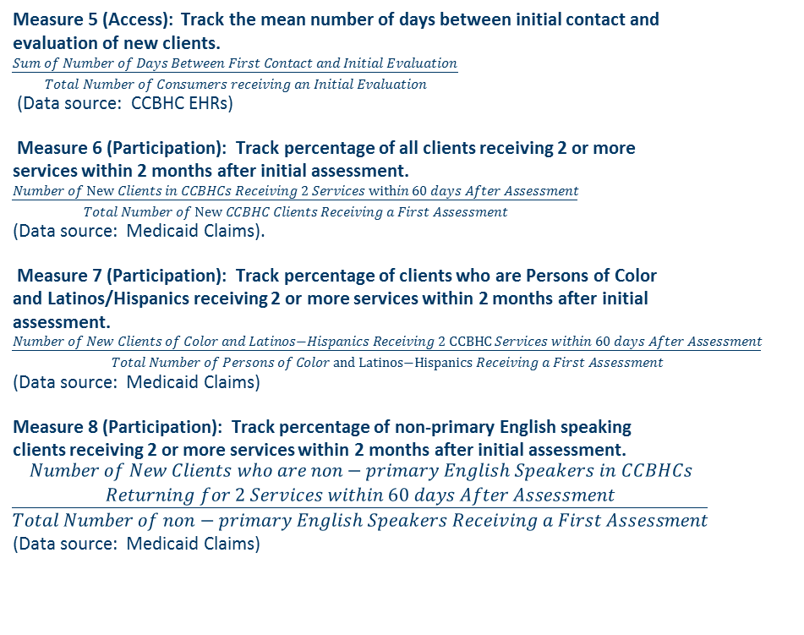
Impact Measures
Measure 1 (Scope of Service): Track proportion of encounters and persons served by peer services in CCBHCs
$\frac{Number of Persons Served by Peers in CCBHCs}{Total Number of Persons Served in CCBHCs}$
(Data source: CCBHC EHRs)
$\frac{Number of Unduplicated Service Visits by Peers in CCBHCs}{Total Number of Service Visits by all Providers in CCBHCs}$
(Data source: Medicaid Claims)
Measure 2 (Participation): Compare percentage of Persons of Color and Latinos/Hispanics receiving CCBHC services to their percentage of Medicaid population in the CCBHC service areas.
${\frac{Number of Persons of Color and Latinos Receiving CCBHC Services}{Total Number of Persons Receiving CCBHC Services}}/{\frac{\#MA Persons of Color and Latinos in CCBHC Service Area}{Total Number of MA Recipients in CCBHC Service Area}}$
(Data sources: CCBHC EHRs/Medicaid enrollment data)
Measure 3 (Participation): Compare percentage of Non-Primary English speakers receiving CCBHC services versus their percentage of Medicaid population in the CCBHC service area.
${\frac{Number of non−primary English Speakers Receiving CCBHC Services}{Total Number of Persons Receiving CCBHC Services}}/{\frac{\#of MA non−primary English Speakers in Service Area}{Total Number of MA Recipients in CCBHC Service Area}}$
(Data sources: CCBHC EHRs/Medicaid Enrollment Data)
Measure 4 (Availability): Track persons served by telemedicine for allowable services in CCBHCs.
$\frac{Number of Persons Served by Telemedicine in CCBHCs}{Total Number of Persons Served in CCBHCs}$
(Data source: Medicaid claims)
Measure 5 (Access): Track the mean number of days between initial contact and evaluation of new clients.
$\frac{Sum of Number of Days Between First Contact and Initial Evaluation }{Total Number of Consumers receiving an Initial Evaluation}$
(Data source: CCBHC EHRs)
Measure 6 (Participation): Track percentage of all clients receiving 2 or more services within 2 months after initial assessment.
$\frac{Number of New Clients in CCBHCs Receiving 2 Services within 60 days After Assessment}{Total Number of New CCBHC Clients Receiving a First Assessment}$
(Data source: Medicaid Claims).
Measure 7 (Participation): Track percentage of clients who are Persons of Color and Latinos/Hispanics receiving 2 or more services within 2 months after initial assessment.
$\frac{Number of New Clients of Color and Latinos−Hispanics Receiving 2 CCBHC Services within 60 days After Assessment}{Total Number of Persons of Color and Latinos−Hispanics Receiving a First Assessment}$
(Data source: Medicaid Claims)
Measure 8 (Participation): Track percentage of non-primary English speaking clients receiving 2 or more services within 2 months after initial assessment.
$$\frac{\begin{aligned}Number of New Clients who are non−primary English Speakers in CCBHCs \\ Returning for 2 Services within 60 days After Assessment\end{aligned}}{Total Number of non−primary English Speakers Receiving a First Assessment}$$
(Data source: Medicaid Claims)

Slide 47
Consumer Level Data Elements
CONSUMER-LEVEL DATA RECORD FIELDS - REQUIRED FOR EACH CONSUMER RECEIVING CCBHC SERVICE
FIELD NAME | FIELD # | FORMAT | BRIEF DESCRIPTION
NPI/UMPI | 1 | X(10) | Unique identifier of the clinic (used for CCBHC billing)
PMIN (MN MHCP Consumer ID) | 2 | X(8) | Unique MHCP Consumer identifier of the Consumer – leads with zeros
Other Consumer ID | 3 | X(12) | Unique clinic identifier of the Consumer for Consumers without PMIN - lead with zeros
Date of Birth | 4 | X(10) | Identifies the date the Consumer was born (MM/DD/YYYY)
Gender | 5 | X(1) | Identifies the gender of the Consumer as Consumer self-identifies
Race | 6 | X(5) | Identifies the race of the Consumer- Up to 5 race codes
Ethnicity | 7 | X(1) | Identifies whether the Consumer is of Hispanic origin or not
Health Insurance status | 8 | X(1) | Health Insurance Status at Status date. CCBHCs should update and pull this information on quarterly basis.
Housing/residential status | 9 | X(2) | Residential Status at Status Date. CCBHCs should update and pull this information on quarterly basis.
Consumer's Preferred Language (Primary) | 10 | X(2) | Identifies the primary language the Consumer
Consumer's Preferred Language (Secondary) | 11 | X(2) | Identifies the secondary language the Consumer
Veteran/Military Status | 12 | X(1) | Identifies if the Consumer is a Veteran or is in Active Duty status at 1st CCBHC service
CCBHC Start Date for Current Consumer | 13 | X(10) | Identifies the date a current Consumer received first CCBHC service (MM/DD/YYYY) starting 7/1/17
Date of First CCBHC Contact for new Consumer | 14 | X(10) | Identifies the date a new Consumer first contact CCBHC to receive service (MM/DD/YYYY) starting 7/1/17
Date of Initial Evaluation for New Consumer | 15 | X(10) | Identifies the date a new Consumer received their Initial Evaluation (MM/DD/YYYY) starting 7/1/17 If consumer is transferred from another CCBHC, leave field blank. New CCBHC should receive I-EVAL from transferred CCBHC.
Consumer Status | 16 | X(2) | Indicates the Consumer’s CCBHC status at the time of reporting. CCBHCs should update and pull this information on quarterly basis. If consumer is transferred from another CCBHC, indicate the consumer's status as "continuing consumer".
Date of Consumer Status | 17 | X(10) | Indicates the date of the Consumer's CCBHC status.
Received Peer Service | 18 | X(1) | Whether Consumer received some Peer Service in CCBHC as of status date : Yes=1; No=0
Received Telemedicine Service | 19 | X(1) | Whether Consumer received some Telemedicine Service in CCBHC as of status date: Yes=1; No=0
Notes:
Data will also be used to calculate the state-lead Housing Status measure
All CCBHC consumers and not limited to Medicaid only

Slide 48
Reporting Schedule
 | Dates of Service | Submission Date
Demonstration Year 1
Quarter 1 | 7/1/2017 to 9/30/2017 | 10/31/2017
Quarter 2 | 10/1/2017 to 12/31/2017 | 1/31/2018
Quarter 3 | 1/1/2018 to 3/31/2018 | 4/30/2018
Quarter 4 | 4/1/2018 to 6/30/2018 | 7/31/2018
Demonstration Year 2
First Half | 7/1/2018 to 12/31/2018 | 1/31/2019
Second Half | 1/1/2018 to 6/30/2019 | 7/31/2019
Notes:
DY1 reporting will occur quarterly to allow for quality checks, data errors, etc.
DY2 reporting will be every six months.
The State will collect data from clinics for the impact measures, as well as the CCBHC Quality Measures on a quarterly basis. This will allow the State data staff an opportunity to provide feedback on progress and flag potential errors, allowing timely adjustment of clinical practices and workflow processes

Slide 49
CCBHC Care Coordination and Managed Care organizations
Leah Montgomery – Health Care Administration - BHH

Slide 50
CCBHC Care Coordination Criteria
Section 223 of the Protecting Access to Medicare Act (PAMA) established federal authority for a Medicaid demonstration project to test new mental health and physical health service delivery and integration model.
Section 223 of PAMA required the Secretary to develop of criteria for certification of CCBHCs. SAMHSA was tasked with development of the criteria. The full criteria can be found on the SAMHSA Section 223 website.

Slide 51
Care Coordination and MA Managed Care
Different requirements for care management and care coordination apply to the different MA managed care products.
CCBHCs need to understand the basic differences between the different managed care products in order to leverage all available resources on behalf of consumers.

Slide 52
Minnesota’s MA Managed Care Products
Families & Children Plans are required to have ability to offer care management (e.g. assessment, care plan, monitoring) to enrollee if necessary. | SNBC Plans are required to offer each enrollee a health risk assessment annually. If care management is needed, the plans are responsible for providing care plan development and monitoring as appropriate based on the needs of the enrollee. | MSHO/MSC+ Plans are required to offer each enrollee a health risk assessment annually. Every MSHO and MSC+ EW enrollee is assigned a care coordinator.

Slide 53
CCBHC MCO Communication Protocol
Managed Care Organization (MCO) Communication Protocol
Background: CCBHCs are authorized under Section 223 of the Protecting Access to Medicare Act (PAMA) (PL 113-93). The goal of CCBHCs is to integrate behavioral health with physical health care, increase consistent use of evidence-based practices, and improve access to high-quality care for individuals covered by Medicaid. Minnesota is one of eight states (including Missouri, New York, New Jersey, Nevada, Oklahoma, Oregon, and Pennsylvania) selected to operate the two-year CCBHC demonstration project. As a condition of participation in the demonstration project, Minnesota must certify that participating clinics meet the federal certification criteria and must ensure that participating clinics are compensated for services through a prospective payment system (PPS).
Care Coordination and Communication: Care coordination is described by the Substance Abuse and Mental Health Services Administration (SAMHSA) as the linchpin of the CCBHC program. The Agency for Healthcare Research and Quality (2014) defines care coordination as involving “deliberately organizing patient care activities and sharing information among all of the participants concerned with a patient’s care to achieve safer and more effective care. This means the patient’s needs and preferences are known ahead of time and communicated at the right time to the right people.”

Slide 54
CCBHC and MCO – Communication Protocol
Suggested process to facilitate communication between the CCBHC and the MCO Care Coordinator
Step One: CCBHC staff determines if the consumer is enrolled in a MCO.
Step Two: CCBHC staff contacts the MCO’s member services department to determine if the enrollee has been assigned a care coordinator.
Step Three: If the consumer has been assigned a care coordinator by the MCO, the CCBHC is responsible for contacting the MCO care coordinator and developing a plan for future communications (e.g. When will the CCBHC or MCO communicate with one another? What is the preferred method of communication? Etc.)

Slide 55
Example - Rudy
Rudy is a 57-year old man who has major depression, hypertension, and diabetes. He has been certified disabled, is enrolled in SNBC, and lives alone.
January – MCO completed a health needs assessment. MCO has referred Rudy for psychotherapy and psychiatry services.
February – SNBC case manager calls Rudy to follow up on referrals. Rudy reports that he has not started mental health services. SNBC case manager refers Rudy to CCBHC.
March – Rudy has completed the CCBHC intake process. CCBHC staff contacts SNBC case manager to notify the MCO that Rudy has begun mental health services and to gather information from MCO (screening information, current providers, other services).
May – CCBHC has been working with Rudy on diabetic education and management. CCBHC staff contact MCO to learn about diabetic education providers within Rudy’s network.

Slide 56
Julie Pearson, MSW, LISW
Minnesota Department of Human Services
CCBHC Project Manager | Mental Health Division
Julie.Pearson@state.mn.us

